Slide 1
Students Performance Dataset Analysis

Slide 2
Introduction & Objective
•Objective:
–• Explore distribution of student scores (Math, Reading, Writing).
–• Visualize relationships using scatter matrix and correlation heatmap.

Slide 3
Dataset Overview
•Filename: Students Performance(1).csv
•Total rows: 1000
•Total columns: 8
•Columns: gender, race/ethnicity, parental level of education, lunch, test preparation course, math score, reading score, writing score

Slide 4
Data Cleaning
• No missing values in this dataset.
• Numeric columns used for analysis: math score, reading score, writing score.
• Categorical columns retained for context (gender, race/ethnicity, lunch, parental education, test preparation).

Slide 5
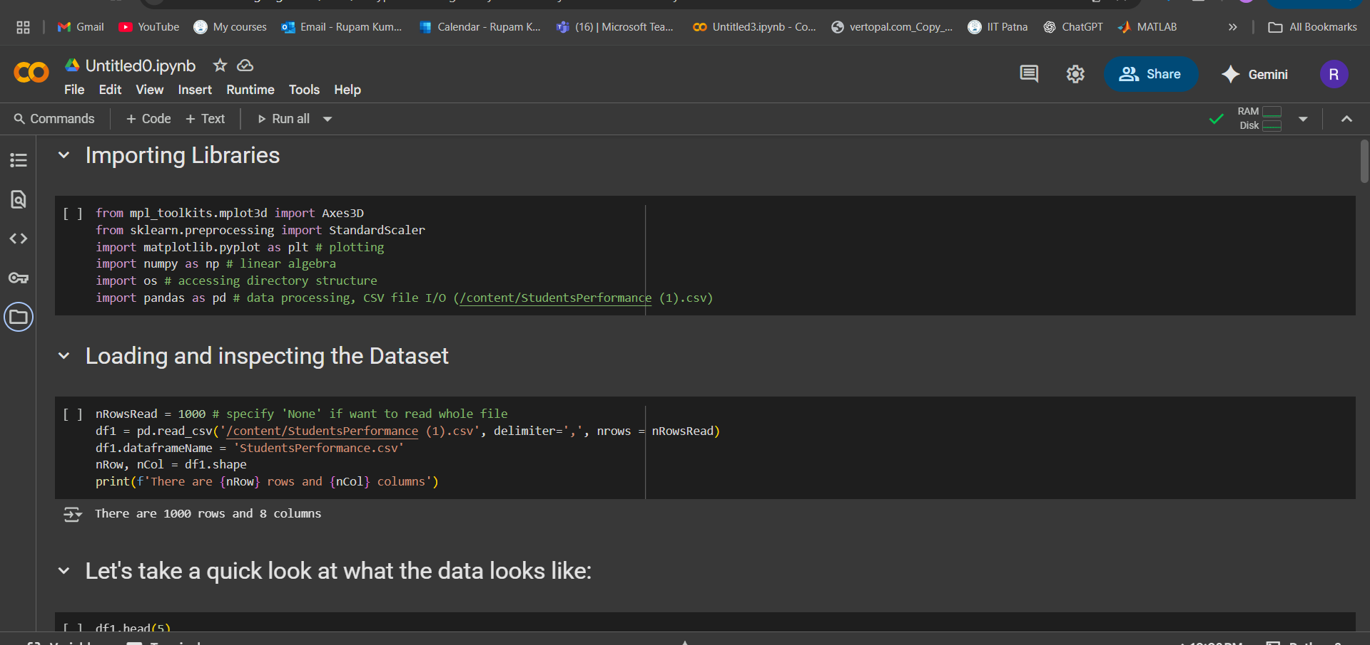
Importing libraries

Slide 6
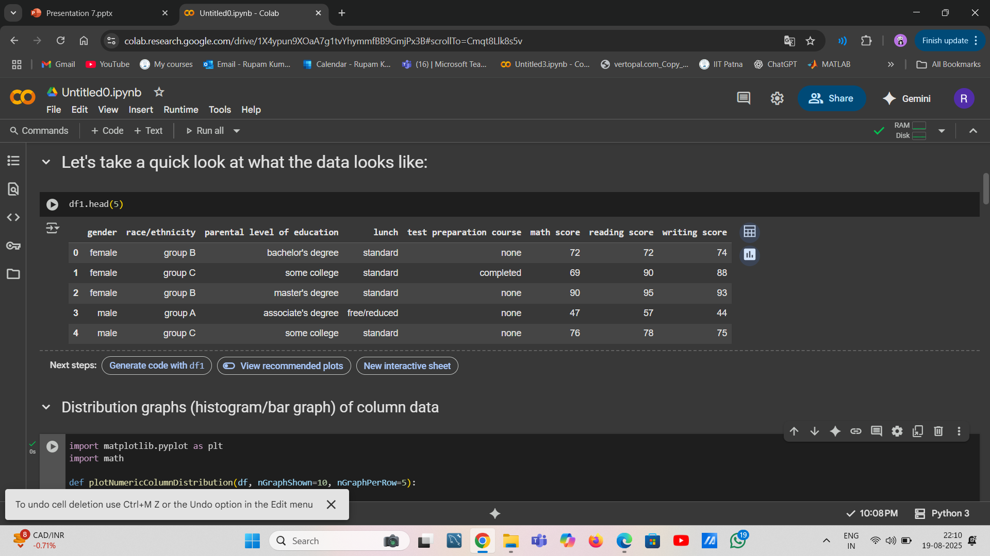
What the data look like:

Slide 7
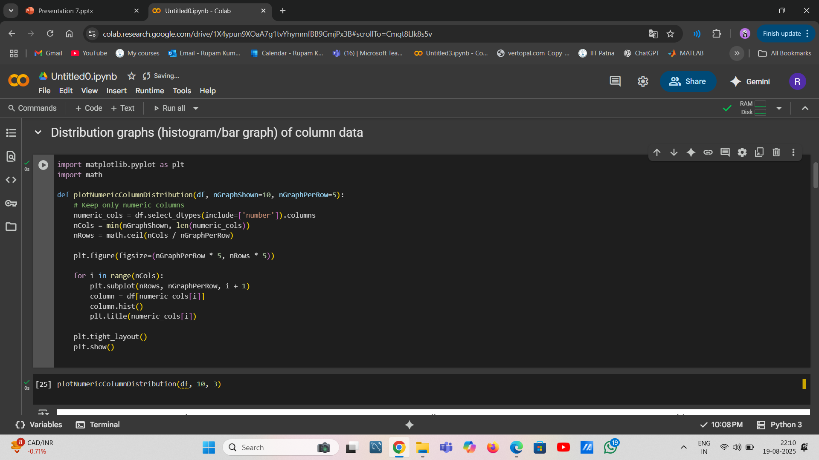

Slide 8
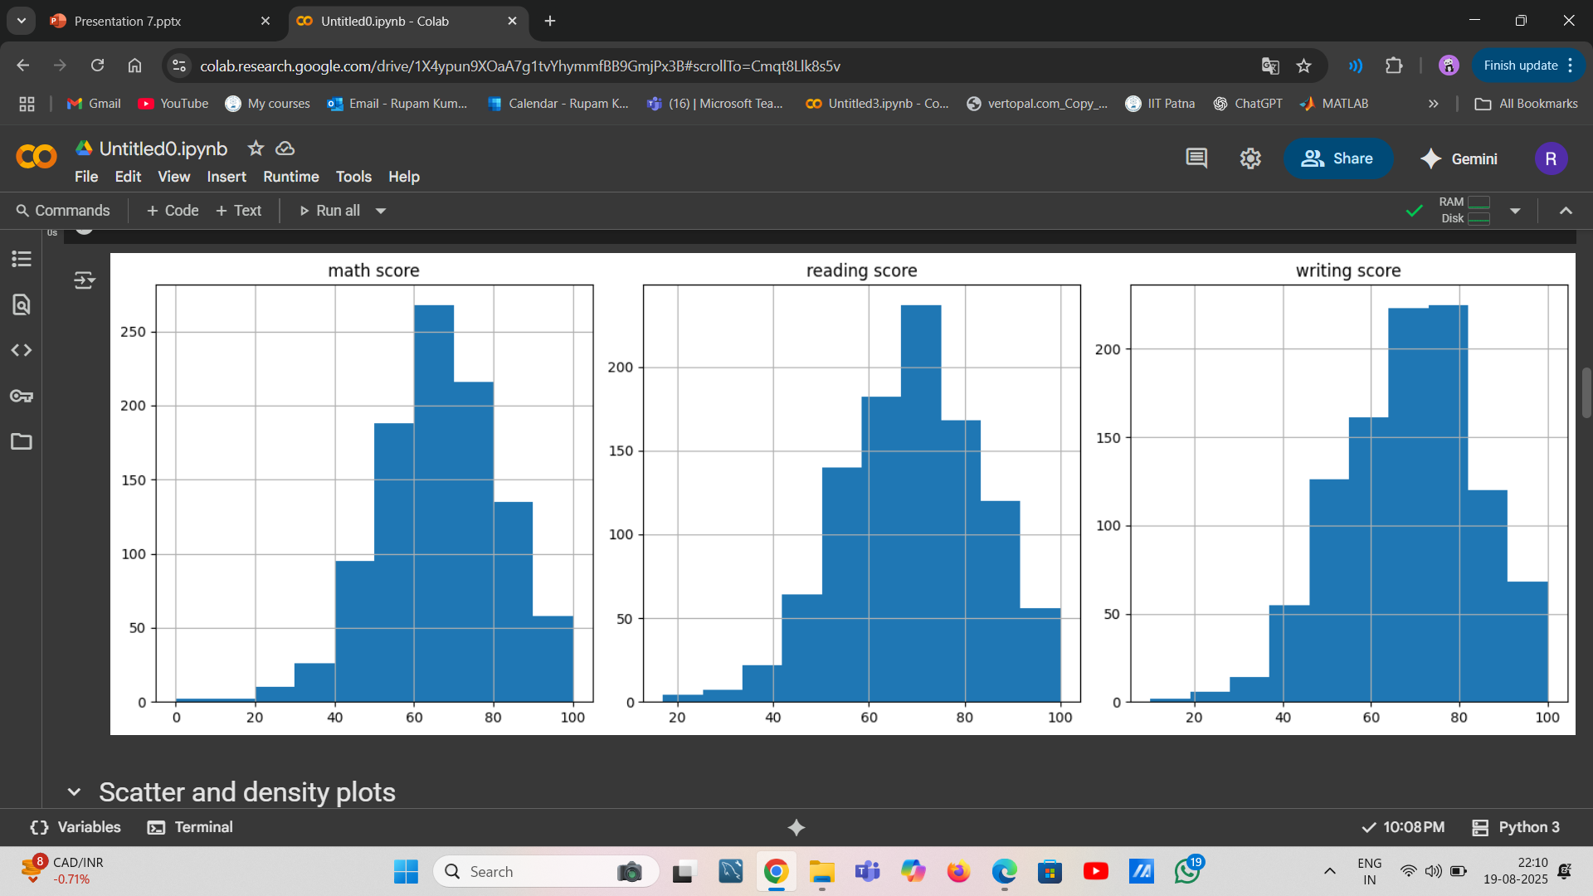
Distribution graphs (histogram/bar graph) of column data

Slide 9
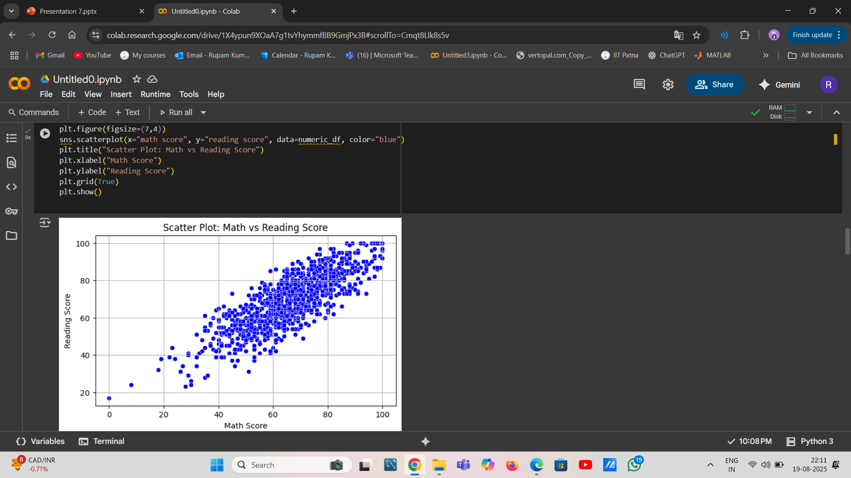
Scatter plot :math vs reading score

Slide 10
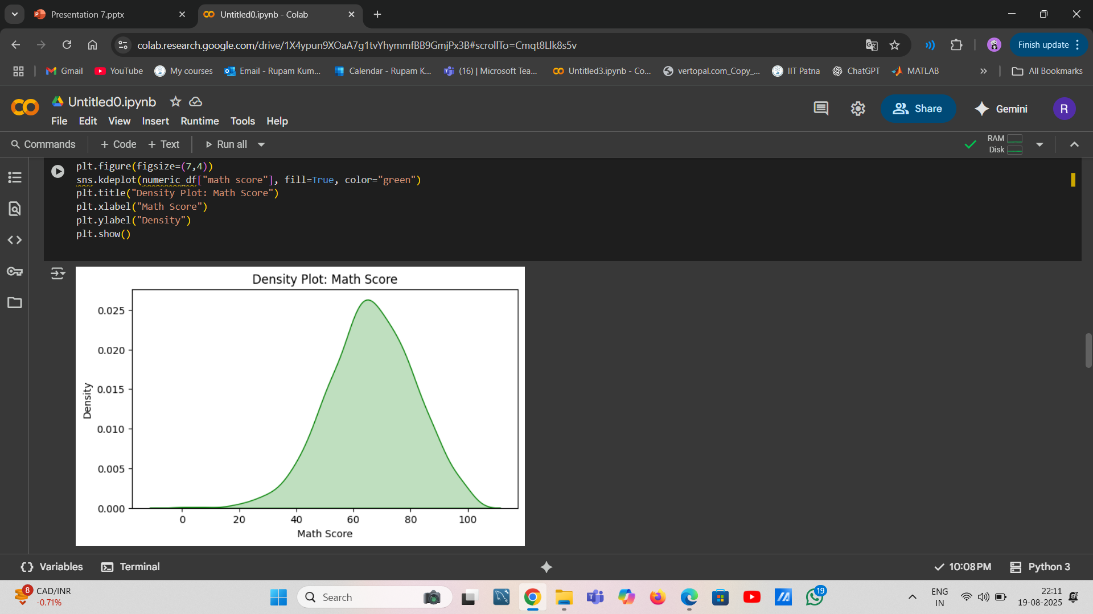
Density plot: math score

Slide 11
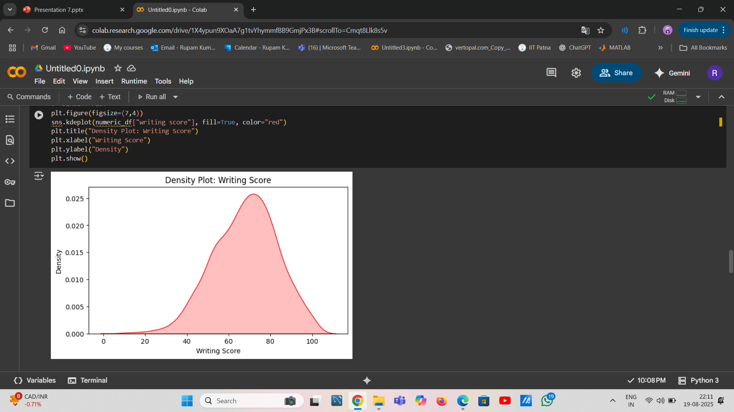
Density plot: writing score

Slide 12
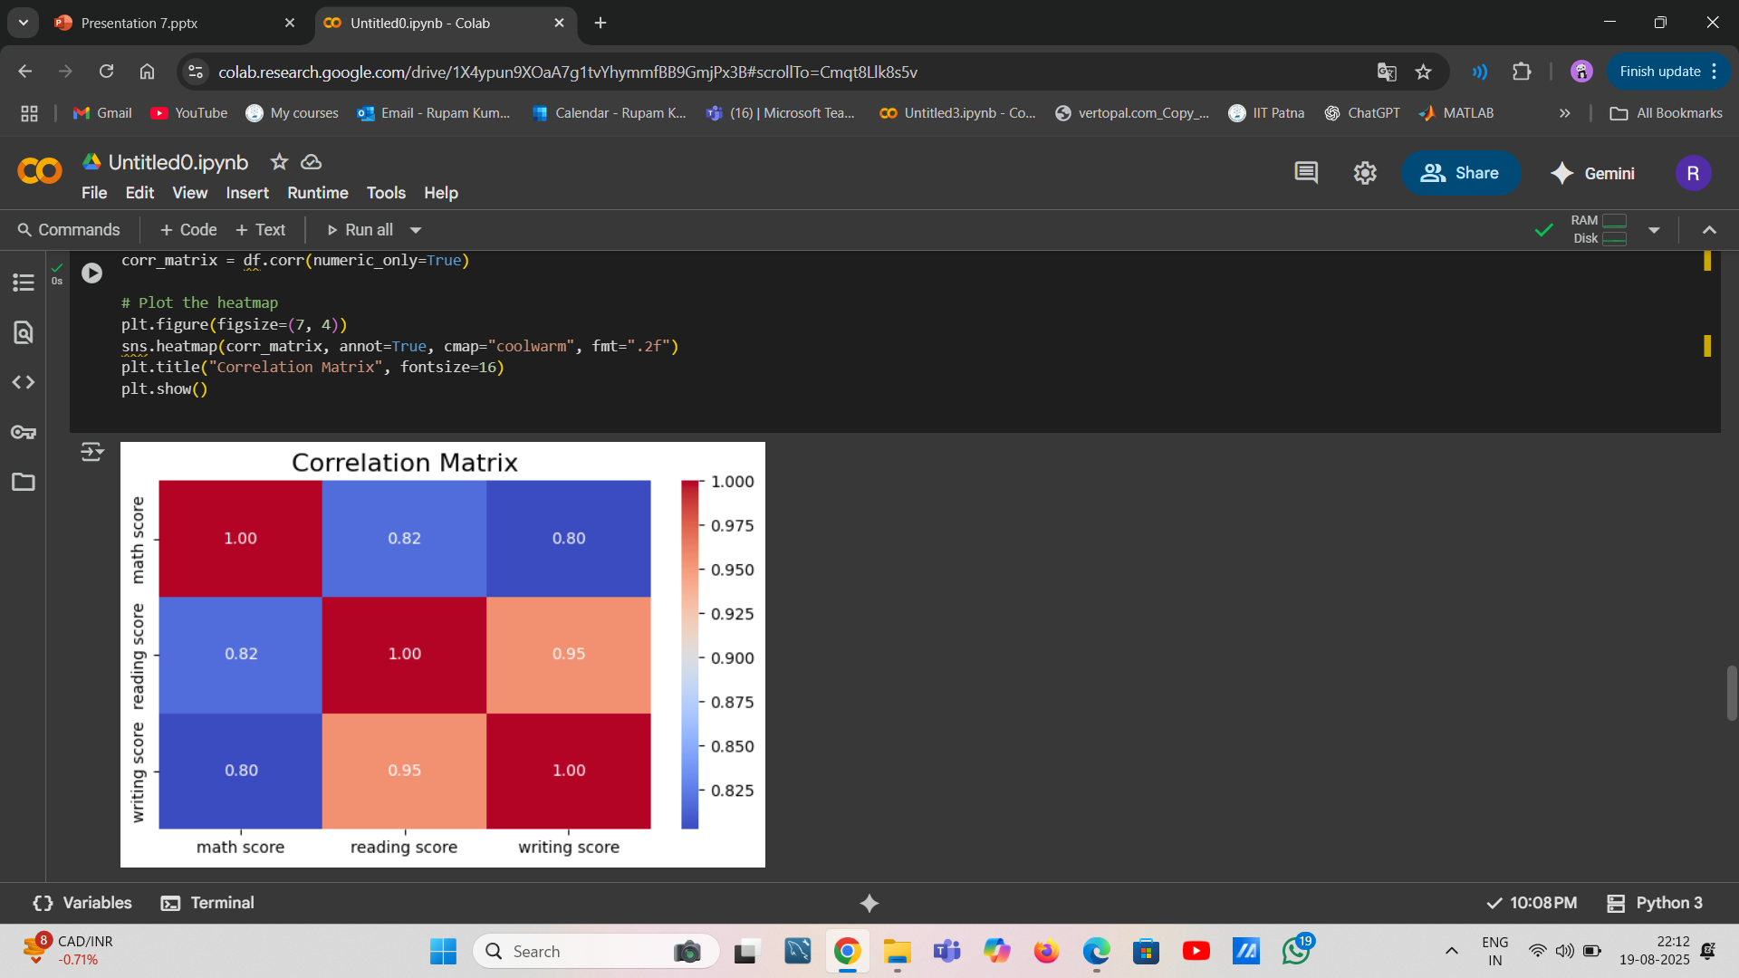
Correlation matrix

Slide 13
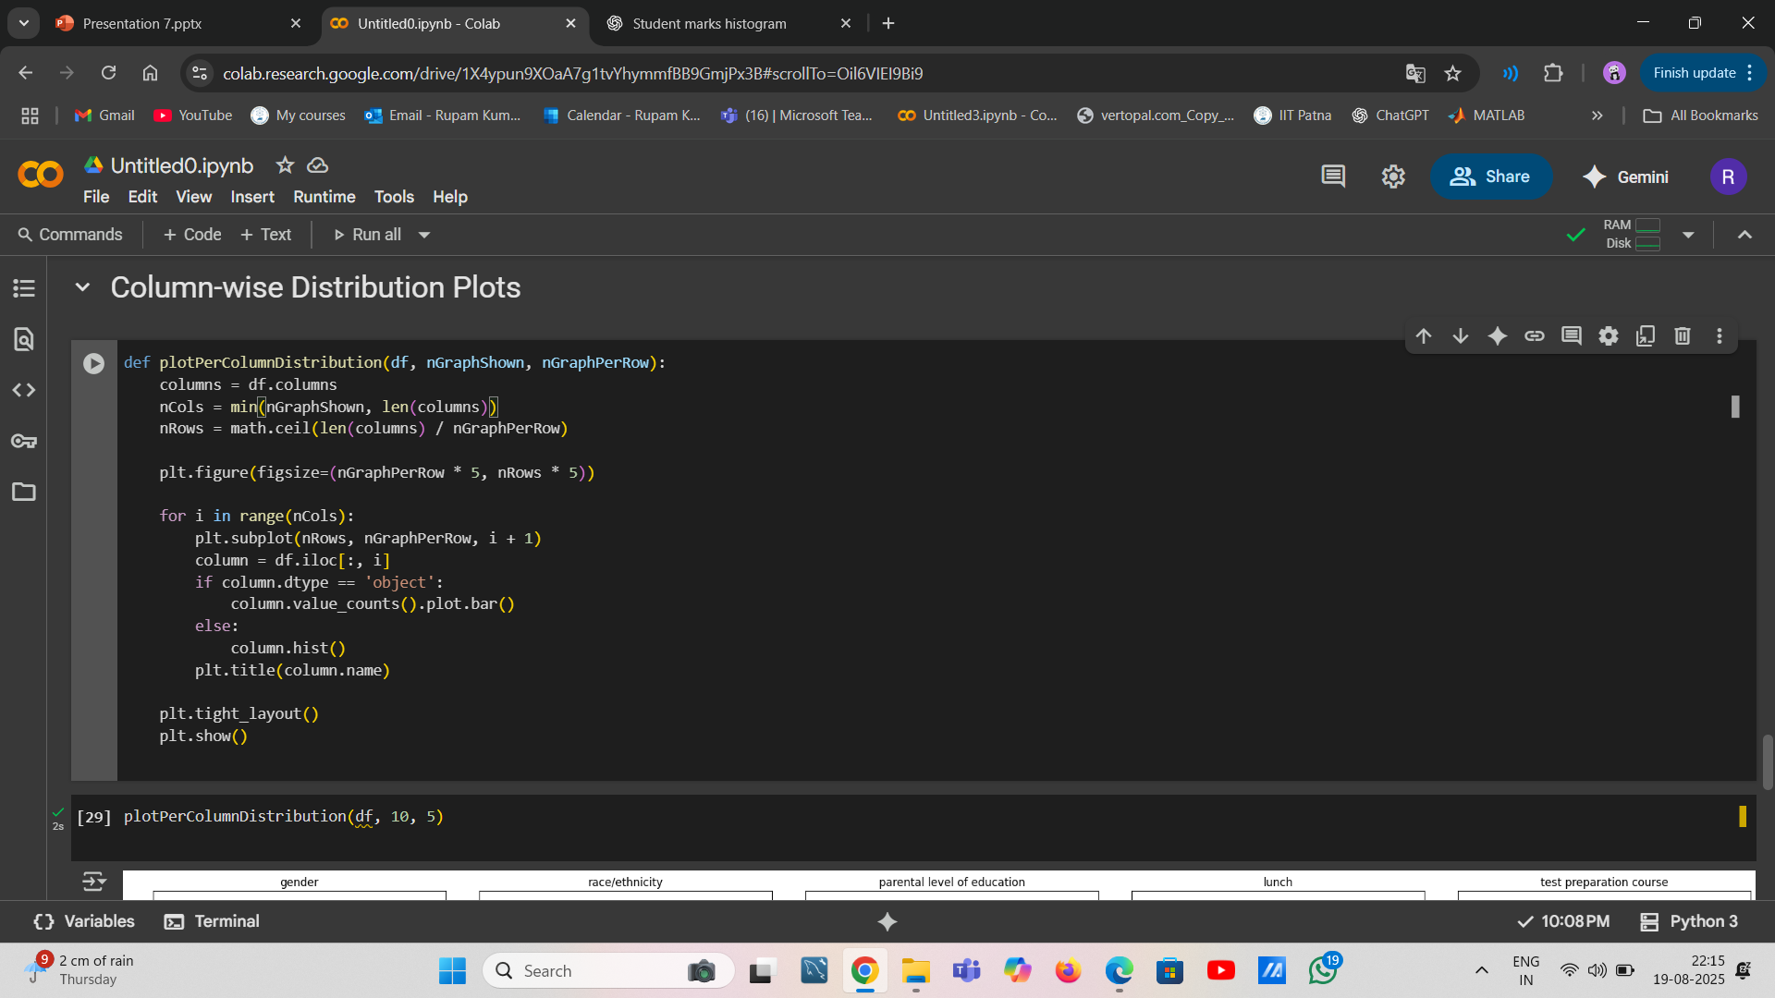
Column –wise distribution plots

Slide 14
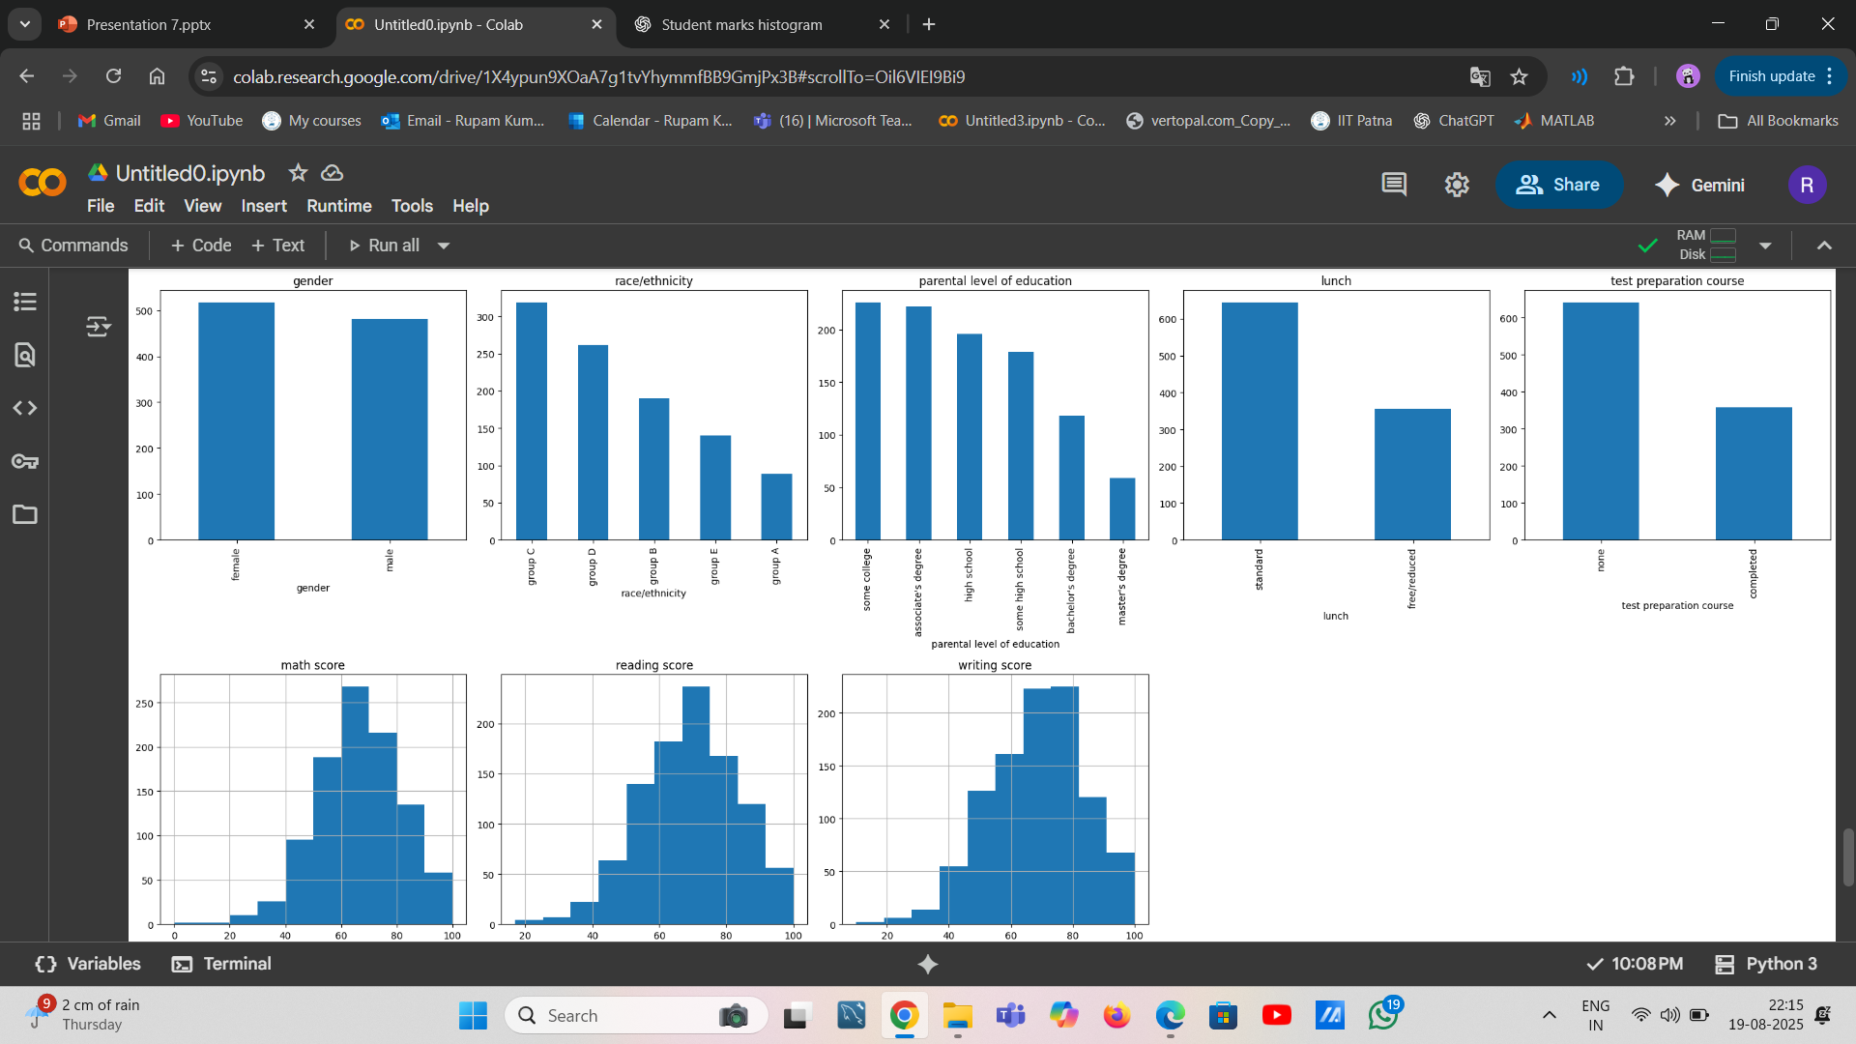

Slide 15
Thank You
Rupam kumari
Roll no-2312res546
BS Comp. Sci & Data Analysis at
Indian Institute of Technology Patna

